Slide 1

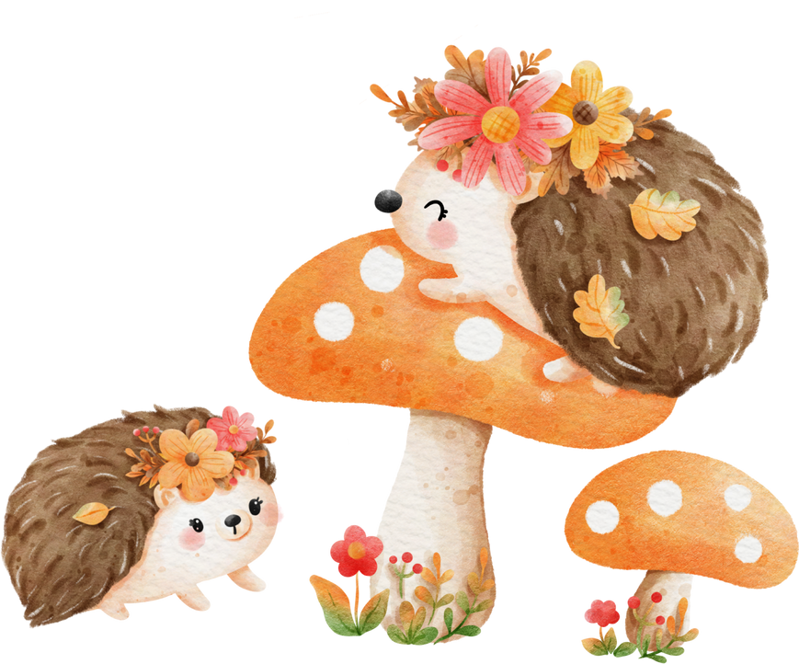
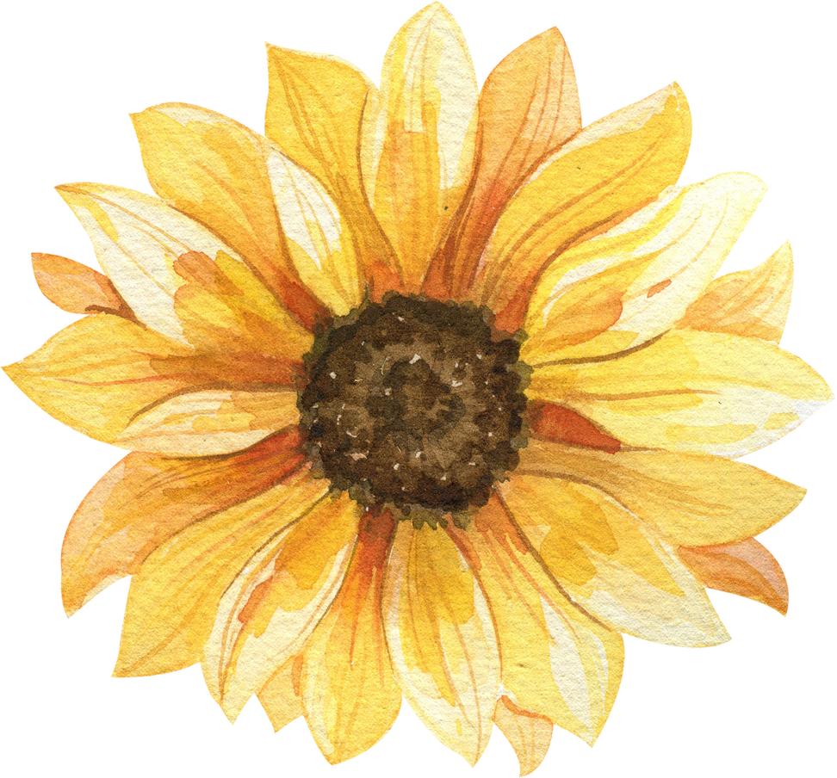
November 2023
Milestones CDC Inc.
GENERAL UPDATES
Our Teacher Resource room is done! Now, we will continue to add items so children will have a wider range of materials to use. We will also be incorporating more “Loose Parts” - open-ended items children can use creatively.
We will continue to sort and organize as we eagerly await our playground grant funds which will create more outdoor seating, storage, and opportunities for deeper play
Our Leadership Team completed a strengths-based coaching series with a coach, and are working to deepen our relationships with each other, the staff, and all the children. We will also be working on shifting responses to children to be more strengths-based. Stay tuned!
DATES TO REMEMBER
HALLWAY DISPLAYS
Oct 30-Nov 2
Nov 10
Nov 14-18
Nov 24-26
Nov 23 & 24
Dec 1
Dec 22
Dec 25-26
Dec 27-28
Dec 29
Jan 1, 2024
Dia de los Muertos
CLOSED
Lety & Aimee, NAEYC
conference
Hmong New Year
CLOSED for Thanksgiving
CLOSED at 12pm
CLOSED
CLOSED
Open for sign ups
CLOSED
CLOSED
We have a diverse group of families and staff. To highlight some of the many traditions our community celebrates, we offer people the opportunity to showcase books, activities, artifacts and more in our hallway.
Coming up - Dia de los Muertos (Paola, Sofia, & Eva), Hmong New Year (Yang, See, Sam, Jennifer), Hanukah (does anyone want to help?), Christmas, and Kwaanza (any helpers?)
See Aimee if you wish to assist
If there is something you celebrate that you wish to help showcase, please let us know!

Slide 2

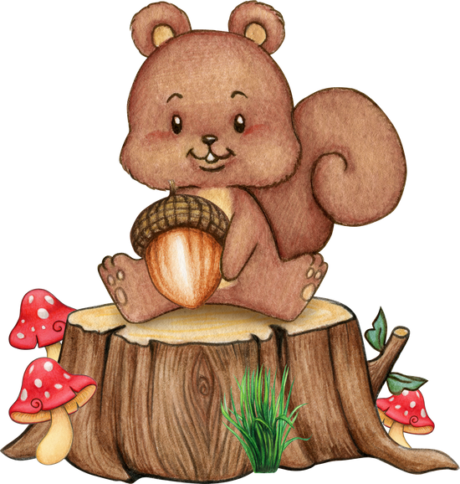
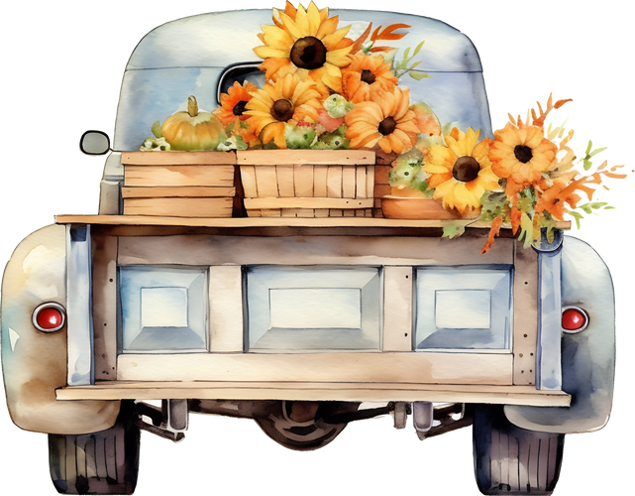
RECYCLED ITEMS WE WANT
We are always on the lookout for interesting items the children can explore, be creative with, practice, and utilize! Here are some things you may be purging or recycling, that we would love to take off your hands:
  Flat sheets, table cloths, shower curtains (these are great for roofs, walls, barriers, and more!)
  Natural materials like rocks, shells, seeds, acorns, pinecones
  Tree stumps! We are looking to create a physical and visual barrier for water play, and intend to create a “Splash Zone” for kids that want to play in water
  Old blankets to sit on outside
  wooden parts, bits, findings, shapes (ends of projects)
  paper tubes, tp tubes, wrapping paper tubes
  Clean empty food containers, especially unique items your child loves at home
  what else do you have? We may have a spot/idea/vision for that thing!
HOLIDAY TIPS
UPCOMING RESOURCES
Holidays can be wonderful, AND hectic!
Here are some quick tips to navigate holidays with young children:
  Under-schedule so you can add things depending on energy and tolerance
  Keep sleep schedules as much as possible
  Children get overstimulated (no matter how fun it seems), so extra patience is usually needed
See this article for more:
https://www.primroseschools.com/blog/holiday-parenting-navigating-stress-and-generating-joy/
We have been working with a Mental Health Professional named Laura to address social-emotional issues both with the staff and the children. She is working with staff on helping children with feelings, managing behaviors, and more.
Laura is from WestEd, and a grant is supporting her work with us. If you come through mid-day you may see her doing observations as well. Let Aimee know if you have any questions!

Slide 3


TK INFORMATION
We have been asked a lot about TK (transitional Kindergarten), so we put together some information for you!
Here are some links:
https://tkcalifornia.org/#:~:text=Transitional%20Kindergarten%20(TK)%20is%20one,serve%20more%20children%20in%20TK!
https://www.first5california.com/en-us/articles/what-is-tk-and-kindergarten-preschooler/
And, our quick “cheat sheets”, that also address what your children get from us at Milestones:
https://drive.google.com/file/d/1_uzco7vYsmesASSPdAw_DR3qiAkUtoWY/view?usp=sharing
https://drive.google.com/file/d/1iIms6coe_g6an2yaiZpORGTlECTS4MIJ/view?usp=sharing
QUICK HELP FOR NEGATIVE
ATTENTION-SEEKING BEHAVIORS
Yep. Negative attention-seeking behaviors. They do it. We don’t understand it.
Here are a few reasons why children do things “to drive us bananas”:
To feel powerful
To see what will happen
To feel connected
To divert attention from something else
Because they are practicing a skill
Because they are curious
Because they need to do the activity to master a skill
...and more!
What do we do?
#1 - above all, focus on what they ARE DOING WELL (you are being gentle with your brother, Thank you for using walking feet, etc.)
Do NOT say, NO, or STOP! It brings attention to the negative action
Avoid eye contact and proximity if it persists, while focusing on the behaviors you DO want to see
See a lead or the front office for more tips!

